Slide 1

Project Area : LOCOMOTION OF QUADRUPED ROBOT Project Topic : QUADRUPED ROBOT – SEARCH AND RESCUE
SAINTGITS
COLLEGE OF ENGINEERING
(AUTONOMOUS)
Mini Project FIRST REVIEW
Presented By :
SANJITH SAJI(MGP22URB085)
SEFIN SURESH(MGP22URB086)
P.ARJUN(MGP22URB077)
S6 RBB
SAINTGITS College of Engineering
Supervisor
Name : Er. CHINN MOHANAN
Designation : Assistant Professor
LEARN . GROW . EXCEL

Slide 2

Contents
Introduction
Literature Review
Methodology
Theoretical Calculations
Control Circuit
Analysis
Budgeting
Roadmap
Reference
LEARN . GROW . EXCEL

Slide 3
INTRODUCTION
Our quadruped robot is designed for search and rescue missions, built for all-terrain mobility with enhanced stability to navigate rough surfaces where wheeled robots fail. Using inverse kinematics and a trot gait algorithm, it ensures precise and balanced movement. Equipped with IMU and ultrasonic sensors, it detects obstacles and adapts in real-time. This project aims to develop a highly agile and intelligent robot capable of autonomous navigation in hazardous environments, aiding in disaster response, exploration, and surveillance.
LEARN . GROW . EXCEL

Slide 4
Literature Review
Sl.No | Title | Authors & Publications | Techniques Used and Observations
1 | “Intelligent Control of Multilegged Robot Smooth Motion: A Review" | YONGYONG ZHAO 1 , JINGHUA WANG 1,2, (Member, IEEE), GUOHUA CAO3 , YI YUAN1 , XU YAO1 , AND LUQIANG QI1 | This study presents gait optimization algorithm and motion planning with its core mechanical aspects from different patterns while it is found out that trot gait algorithm is more efficient.
LEARN . GROW . EXCEL

Slide 5
Literature Review (Contd…)
Sl.No | Title | Authors & Publications | Techniques Used and Observations
2 | "ANYmal: A Dynamic Quadruped Robot" | Hutter et al., IEEE Robotics and Automation Letters (RAL), 2017 | ANYmal uses torque-controlled joints for agile locomotion. It is capable of autonomous terrain adaptation and energy-efficient movement, supported by real-time feedback from onboard sensors.
3 | "Cheetah 3: Blind Locomotion" | Kim et al., IEEE/RSJ IROS, 2018 | Cheetah 3 achieved blind locomotion using proprioceptive feedback and model-based control. The robot successfully navigates stairs and obstacles without relying on vision.
LEARN . GROW . EXCEL

Slide 6
Literature Review (Contd…)
Sl.No | Title | Authors & Publications | Techniques Used and Observations
4 | "Vision-Assisted Quadruped Control" | Kolvenbach et al., Robotics and Automation Letters (RAL), 2019 | The sensor integration and perception improve the stability and decision-making of quadruped robots on complex terrains.
5 | BigDog: The Rough-Terrain Quadruped" | Raibert et al., IEEE Robotics and Automation, 2008 | BigDog uses hydraulic actuators and advanced dynamic stability control to navigate rough terrain. The robot successfully carried heavy loads, demonstrating robustness in extreme environments.
LEARN . GROW . EXCEL

Slide 7
Literature Review (Contd…)
Sl.No | Title | Authors & Publications | Techniques Used and Observations
6 | “Dynamic locomotion of quadruped robots.” | K.Y. LEE and J.S.KIM | The sensor integration and perception improve planning of the different available gait algorithms.
LEARN . GROW . EXCEL

Slide 8
METHODOLOGY
Concept & Design
Defined project objectives for a search and rescue quadruped.
Designed the robot’s mechanical structure from an open source.
Kinematics & Gait Planning
Developed inverse kinematics for precise leg movement.
Implemented a trot gait algorithm for stable locomotion.
Hardware Integration
Assembled components: Raspberry Pi, servo motors, ultrasonic sensors, and IMU (MPU6050).
Designed and tested electronic circuits for motor control and sensor interfacing.
ROS2 & Simulation
Developed custom ROS2 controllers for motion execution.
Used Gazebo for simulation before real-world testing.
Testing & Optimization
Conducting multiple real-world trials for stability and responsiveness.
Fine-tuned algorithms for efficient movement and obstacle avoidance.
LEARN . GROW . EXCEL

Slide 9
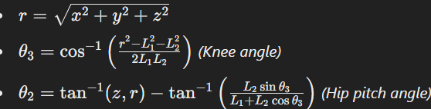
THEORETICAL CALCULATIONS
Inverse Kinematics Using DH Parameters:
To compute the joint angles (𝜃1, 𝜃2, 𝜃3) for each leg, we work backward from the desired foot position (𝑥,𝑦,𝑧) using the Denavit-Hartenberg (DH) parameters:
𝜃𝑖 (Joint angles – to be calculated)
𝛼𝑖 (Link twists)
𝑎𝑖 (Link lengths)
𝑑𝑖 (Link offsets)
Step 1: Solve for Hip Yaw Joint (𝜃₁)
Determines the rotation of the leg in the XY plane.
𝜃₁ = atan2(y, x)
Step 2: Solve for Hip Pitch and Knee Joints (𝜃₂, 𝜃₃)
Use the Law of Cosines to determine joint angles based on the distance r from the hip to the foot.

Slide 10
Control Circuit
• Servo Motors to PCA9685 Driver: – 12 servo motors (3 per leg) are connected to the PCA9685 PWM driver board. – The board generates precise PWM signals to control each servo's position.
• PCA9685 to ESP32 Microcontroller: – The PCA9685 communicates with the ESP32 via the I2C interface. – The ESP32 serves as the central controller executing gait algorithms .
• Sensor Integration: – Ultrasonic sensors and an IMU provide real-time data for obstacle detection and stability. – These sensors feed information into the ESP32 for dynamic adjustments during locomotion.
• Power Supply Connections: – Variable power supply, regulated by a UBEC, delivers stable power to both the high-current servos and the microcontroller. – Separate power paths ensure that sensor and control circuits remain unaffected by servo power fluctuations.

Slide 11
VALIDATION AND TESTING
IMU and ESP32 successfully tested Communication with the micro-ROS agent verified Raspberry Pi tested and confirmed to be functional Raspberry Pi successfully communicates with the ESP32 ROS2 nodes have been created to receive sensor data, ensuring real-time feedback from the hardware Currently developing embedded C code for gait planning, leveraging DH parameters as references to achieve efficient and stable locomotion

Slide 12
Budgeting
• Motors (12 Servos): – 12 × ₹1500 = ₹18,000
• 3D Printing: – ₹5000 (Structural components using PLA+ at 30% infill)
• Controller & Sensors: – Raspberry Pi Bundle: ₹9400 – ESP32 Module: ₹650 – IMU Sensor: ₹270
– Motor Driver: ₹200
• Support Items: – Nuts, bolts, fasteners, etc.: ₹3000

Slide 13
Duration Name of task | Week 1 | Week 2 | Week 3 | Week 4 | Week 5 | Week 6
Literature Survey |  |  | Completed
Data Collection | Completed | Completed | Completed
Design |  | Completed
Programming |  |  |  | Completed | To be Completed
Implementation |  |  |  |  |  | To be Completed

Slide 14
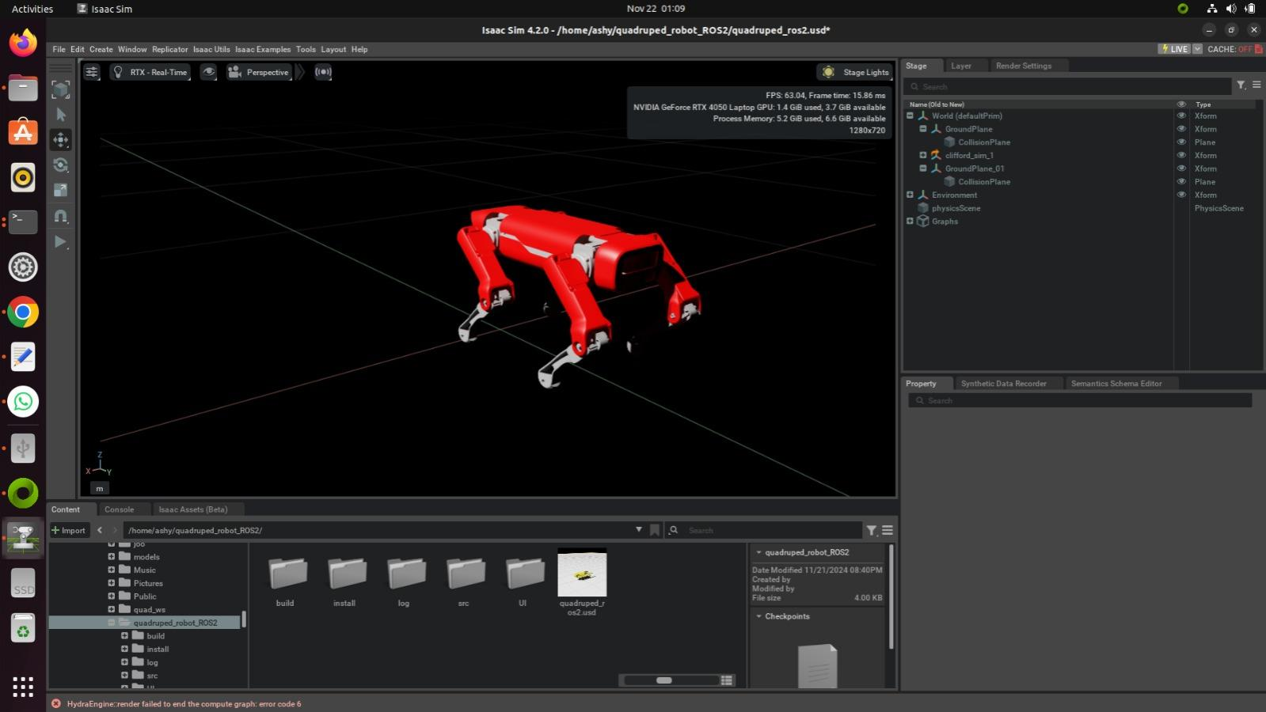

Slide 15
References
"Quadruped Robot Design and Control: A Review" by L. B. Freeman, J. R. S. Gamboa, and D. H. D. Chien.
Boston Dynamics - Spot Robot
"The Roboticists Guide to the Control of Quadruped Robots" by Antonio Bicchi and Lorenzo Marconi.
"Quadruped Robot Locomotion: A Survey" by Sung-Min Kim and Joon Ho Choi.

Slide 16
References
5. "The Development and Control of the Quadruped Robot LAURA" by M. J. Schmidt, J. E. DeRuntz, and R. A. Knepper
6. "Dynamic Locomotion of Quadruped Robots: Theory and Application" by K. Y. Lee, J. S. Kim, and H. Y. Lee

